Slide 1
operators

Slide 2
Introduction
Operators are the symbols which operates on value or a variable. It tells the compiler to perform certain mathematical or logical manipulations.
Can be of following categories:
Unary – requires a single operand
Binary – requires two operands
Ternary – requires three operands
Following are the types of operators:
Arithmetic
Relational
Logical
Bitwise
Assignment
Conditional (ternary)
Increment/Decrement
Special

Slide 3
Types of operators
Types of operators | Description
Arithmetic operators (binary) | These are used to perform mathematical calculations like addition, subtraction, multiplication, division and modulus.
Assignment operators (binary) | These are used to assign the values for the variables in programs.
Relational operators (binary) | These operators are used to compare the value of two variables.
Logical operators (binary) | These operators are used to perform logical operations on the given two variables.
Bitwise operators (binary) | These operators are used to perform bit operations on given two variables.
Conditional operators (ternary) | Conditional operators return one value if condition is true and returns another value is condition is false.
Increment/Decrement operators (unary) | These operators are used to either increase or decrease the value of the variable by one.
Special operators | sizeof( )

Slide 4
Arithmetic Operators
Operator | Description | Example (A is 10, B is 20)
+ | Adds two operands | A + B will give 30
- | Subtracts second operand from the first | A – B will give -10
* | Multiplies both operands | A * B will give 200
/ | Divides numerator by de-numerator | B/A will give 2 and A/B will give 0.5(if float) and 0(if int)
% | Modulus Operator and remainder of after an integer division | B % A will give 0 and A % B will give 10
General form is operand1 operator operand2

Slide 5
Assignment Operators
Operator | Description | Example
= | Simple assignment operator, Assigns values from right side operands to left side operand | C = A + B will assign value of A + B into C
+= | Compound assignment operator, Add and assignment operator. It adds right operand to the left operand and assign the result to left operand | C += A is equivalent to C = C + A
-= | Compound assignment operator, Subtract and assignment operator. It subtract right operand from the left operand and assign the result to left operand, others would be “ *=, /=, %= “ | C -= A is equivalent to C = C - A
<<= | Left shift and assignment operator | C <<= 2 is same as C = C << 2
>>= | Right shift and assignment operator | C >>= 2 is same as C = C >> 2
&= | Bitwise and assignment operator, others would be “^=, |=“ | C &= 2 is same as C = C & 2
General form is v op= exp where v is a variable and op is a binary arithmetic operator. This statement is equivalent to v = v op(exp)

Slide 6
Relational Operators
Operator | Description | Example (A is 10, B is 20)
== | Checks if the values of two operands are equal or not, if yes then condition becomes true. | A == B will give 0
!= | Checks if the values of two operands are equal or not, if values are not equal then condition becomes true. | A != B will give 1
> | Checks if the value of left operand is greater than the value of right operand, if yes then condition becomes true. | A > B will give 0
< | Checks if the value of left operand is less than the value of right operand, if yes then condition becomes true. | A < B will give 1
>= | Checks if the value of left operand is greater than or equal to the value of right operand, if yes then condition becomes true. | A >= B will give 0
<= | Checks if the value of left operand is less than or equal to the value of right operand, if yes then condition becomes true. | A <= B will give 1
General form is operand1 relational-operator operand2 takes a value of 1(int) if the relationship is true and 0(int) if relationship is false.

Slide 7
Logical Operators
Operator | Description | Example (A is 10, B is 20)
&& | Called Logical AND operator. If both the operands are non-zero, then condition becomes true. | (A>=10) && (B>15) will give 1 (A>10) && (B>15) will give 0
|| | Called Logical OR Operator. If any of the two operands is non-zero, then condition becomes true. | (A>10) || (B>15) will give 1
! | Called Logical NOT Operator. Use to reverses the logical state of its operand. If a condition is true then Logical NOT operator will make false. | (A>10) will give 0 !(A>10) will give 1
General form is operand1 logical-operator operand2 takes a value of 1(int) if the relationship is true and 0(int) if relationship is false.
expr1 && expr2 has a value 1 if expr1 and expr2 both are nonzero.
expr1 || expr2 has a value 1 if expr1 and expr2, any one of them is nonzero.
!expr1 has a value 1 if expr1 is zero else 0.

Slide 8
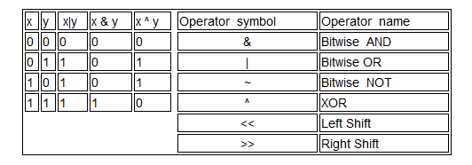
Bitwise Operators
Operator | Description | Example (A is 60, B is 13)
& | Binary AND Operator copies a bit to the result if it exists in both operands. | (A & B) = 12 (0000 1100)
| | Binary OR Operator copies a bit if it exists in either operand. | (A | B) = 61 (0011 1101)
~ | Binary NOT Operator is unary and has the effect of 'flipping' bits. | (~A) = -61 (1100 0011 in 2’s complement form)
^ | Binary XOR Operator copies the bit if it is set in one operand but not both. | (A ^ B) = 49 (0011 0001)
<< | Binary Left Shift Operator. The left operand’s value is moved left by the number of bits specified by the right operand. | A << 2 will give 240 which is 1111 0000
>> | Binary Right Shift Operator. The left operand’s value is moved right by the number of bits specified by the right operand. | A >> 2 will give 15 which is 0000 1111

Slide 9
Bit Wise Complement Operator
For any integer n, the bitwise complement of n will be -(n+1).
Bitwise complement of N = ~N (represented in 2’s complement form).
2’complement of ~N= -(~(~N)+1) = -(N+1).

Slide 10
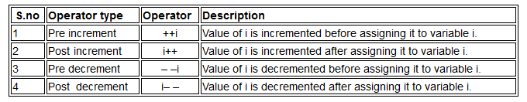
Increment/Decrement Operators
Increment operators are used to increase the value of the variable by one and decrement operators are used to decrease the value of the variable by one in C programs.
Syntax:
Increment operator: ++var_name; (or) var_name++; Decrement operator: – -var_name; (or) var_name – -;

Slide 11
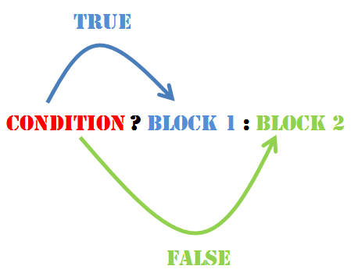
Conditional Operator
A ternary operator pair “?:” is available to construct conditional expression of the form
Exp1 ? Exp2 : Exp3 where Exp1, Exp2 and Exp3 are expressions.
The operator ?: works as follows: Exp1 is evaluated first. If it is nonzero (true), then the expression Exp2 is evaluated and becomes the value of the expression.
If Exp1 is false, Exp3 is evaluated and its value becomes the value of the expression.
Syntax
(Condition? true_value: false_value);
E.g. a = 10;
b = 15;
x = (a > b) ? a : b

Slide 12
Special Operators
To get the exact size of a type or a variable on a particular platform, you can use the sizeof operator. The expressions sizeof(type) yields the storage size of the object or type in bytes.
int a; sizeof(a) → 2 bytes (in 32 bit machine) and 4 bytes (in 64 bit machine)
float b; sizeof(b) → 4 bytes
double c; sizeof(c) → 8 bytes
char d; sizeof(d) → 1 byte

Slide 13
Precedence and Associativity
Precedence and Associativity are two characteristics of operators that determine the evaluation order of subexpressions in absence of brackets.
Please check document of precedence and associativity.
Some points:
All operators with same precedence have same associativity → This is necessary, otherwise there won’t be any way for compiler to decide evaluation order of expressions which have two operators of same precedence and different associativity. For example + and – have same associativity.
Associativity is only used when there are two or more operators of same precedence.

Slide 14
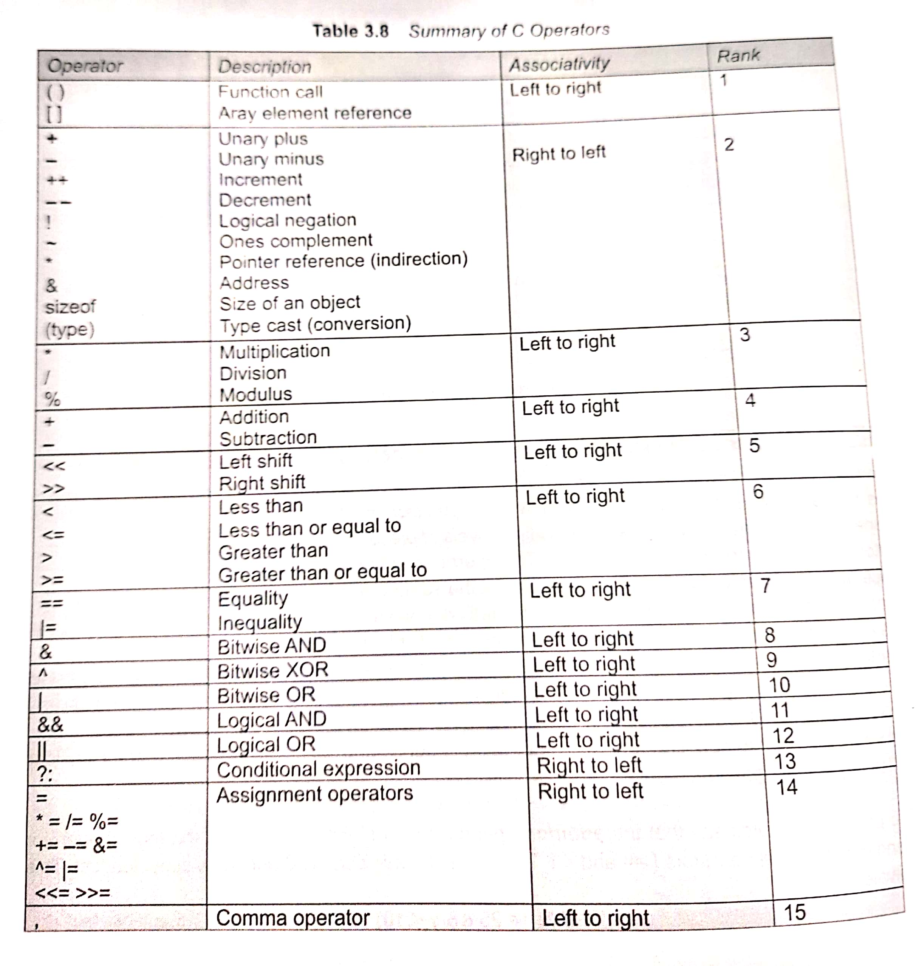

Slide 15
PUMASREBLTAC (PRECEDENCE)
TAU (RIGHT TO LEFT)

Slide 16
Examples
3+4*4>5*(4+3)-1
x=5,y=5,z
z=y + x * y-- + ++x;
printf(“%d%d%d”,x,y,z);
Notes:
3+4*4>5*(7)-1=3+16>34=19>34
Answer- 0
2. Unary Right to left
Z= 5+6*5+6= 41

Slide 17
Example
a=0, b=1,c=-1
d= --a*(5+b)/2-c++*b;
printf(“%d”,d);
Notes:
-1*(6)/2-(-1)*1= -2

Slide 18
Thank you
ANY QUESTIONS???

